Slide 1
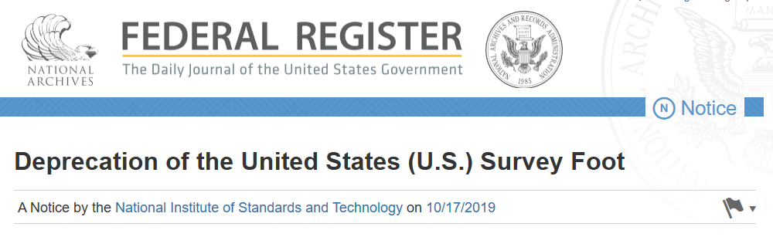
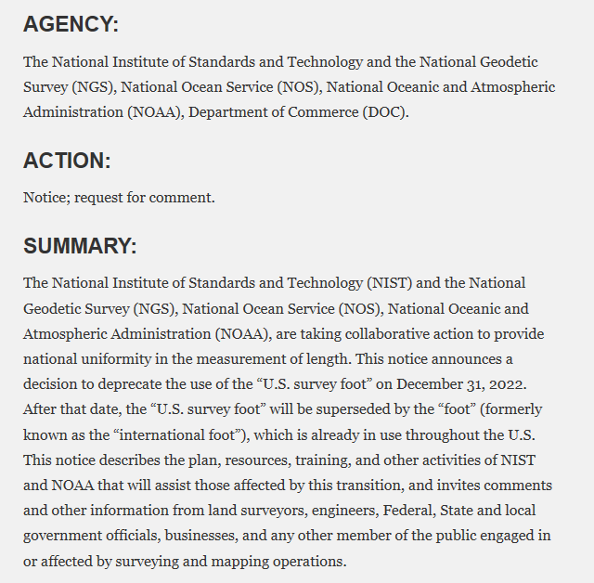

Slide 2
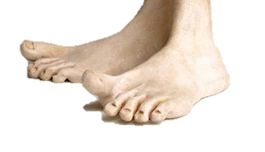
A tale of two feet
Two versions of “foot” in current use:
“Old” U.S. survey foot
“New” international foot
‭1 ft = 0.3048006096…‬ m
1 ft = 0.3048 m exactly
differ by
2 parts per million (ppm) or 0.01 ft/mile
  A real problem with real costs
Notes:
It’s likely everyone watching this webinar knows about the problem: there are two nearly identical versions of the foot in current use in the U.S.;
They differ by 2 parts per million (ppm), or only 0.01 ft per mile, or slightly more than a tenth of an inch in a mile.
Despite (or actually because of) the very small difference, it has become a REAL problem with REAL costs.

Slide 3
An NGS proposal
Only one foot after 2022 (1 foot = 0.3048 meter)
  Make official through NIST
  NO option for U.S. survey foot
NGS will help with the transition
  Will fully support backward compatibility
  Use “correct” foot for SPCS 83 and SPCS 27
  Automatically done by NGS products and services
Guiding ideas
  Best opportunity to make the change
  Of all changes in 2022, this is the least significant
  Will make things better
  About the future, not the past
Notes:
NGS proposes that there be only ONE official definition of the foot after 2022, and if done will be accomplished through NIST.
Considering getting rid of word “international”, and just call it the “foot” (that is how it is handled in some software, such Esri’s). People just seem to not like the “international” label. Maybe call if the “American freedom foot.” But seriously, dropping a descriptor solidifies the idea that there is only one foot in the U.S. Keeping the descriptor implies there is more than one foot.
Have NO option for sft after 2022. It will only be used for the past (legacy applications).
NGS will help!
We will try to make the change as simple and painless as possible.
Our products and services will automatically support backward compatibility.
Idea here is that we are trying to make things better by fixing a long-standing problem for the future (not the past). Yes, there will be some difficulties. But at least they will diminish over time. If we do nothing, these problems will never go away.
If you think changing from sft to ift is a big problem, then perhaps you don’t quite understand the other changes that are coming in 2022:
The change from sft to ift is really just a small (2 ppm) scale change. That is smaller than the change in scale for SPCS2022 zones, and that is only PART of the change that will occur for State Plane.
Coordinates in NSRS2022 will change with time. In fact, the entire frame will be time-dependent. Assumptions about control coordinates never changing will have to be abandoned.
The “vertical” datum will be replaced with a geopotential datum based on a gravimetric geoid (rather than leveling). This, too, will have a time-dependent component.
There will be changes in how GNSS, leveling, and total station survey surveys are performed, reduced, processed, and adjusted.
By comparison, the change from sft to ift is so miniscule that it is well within the noise of the other changes.
In short, if you think the change in foot definition is too difficult, then its hard to see how you could deal with these other much larger and vastly more complex changes.

Slide 4
The problem (and some questions)
Two versions of same unit in current use
  “New” international foot and “old” U.S. survey foot
  “New” shorter than “old” by 2 ppm (0.01 ft per mile)
  A real problem with real costs
What’s in a name?
  “U.S. survey” versus “international”
Who is using U.S. survey feet?
  Surveyors exclusively, in most (not all) states
  But it impacts everyone
What should we do?
  Begin with a conversation
Notes:
It’s likely everyone watching this webinar knows about the problem: there are two nearly identical versions of the foot in current use in the U.S.;
They differ by 2 parts per million (ppm), or only 0.01 ft per mile, or slightly more than a tenth of an inch in a mile.
Despite (or actually because of) the very small difference, it has become a REAL problem with REAL costs.
What’s in a name? That which we call a “foot” by any other word would smell as… sweet? Maybe that’s not he best analogy for the foot…
“U.S. survey foot” sounds patriotic, is surveyor-centric…
“International foot” sounds like a New World Order, UN sanctioned sort of thing, with perhaps a whiff of socialism…
Is the name really part of the problem? I hope note, but emotion does play a role. We are not entirely rational creatures after all (myself included).
Surveyors are really the only users of the U.S. survey foot (sft). They are also among the very few who even know of its existence. In schools and colleges they only teach students about the official international foot (ift). However, because people use the products created by surveyors, they end up using the sft without even knowing it.
Want to have a conversation about this, get all of us on the same page. So I will present facts to facilitate informed discussion (sprinkled with some opinions…)

Slide 5
Kicking the can (Federal Register)
1959
“Any data expressed in feet derived from and published as a result of geodetic surveys within the United States will continue to bear the following relationship as defined in 1893:
1 foot = 1200/3937 meter
The foot unit defined by this equation shall be referred to as the U.S. Survey Foot and it shall continue to be used, for the purpose given herein, until such a time as it becomes desirable and expedient to readjust the basic geodetic survey networks in the United States, after which the ratio of a yard, equal to 0.9144 meter, shall apply.”
https://geodesy.noaa.gov/PUBS_LIB/FedRegister/FRdoc59-5442.pdf
Signed by NBS and C&GS directors, approved by Secretary of Commerce, June 25, 1959
Notes:
Federal Register Notice (1959) establishing ift and (temporary) sft
Official adoption of ift (1 ft = 0.3048 m) nationwide.
Temporary exception granted for geodetic surveys (including State Plane coordinates), to accommodate C&GS.
Mandates that ift shall be adopted after readjustment of U.S. geodetic network. This is not a “recommendation” or a “suggestion.” At the time this was published, “shall” was used in legal documents as mandatory (nowadays the usage of “shall” as mandatory is discouraged in legal documents).
Co-issued and signed by NBS and C&GS directors.
This FRN delayed full adoption of the ift, and promoted continued use of the sft for all surveying (not just geodetic surveys), and it is how we got into the situation we are in today.

Slide 6
More Federal Register Notices
Surveying and mapping only (pending analysis, never resolved)
Proposed permanent use of U.S. Survey Foot
Restatement that metric used for U.S.
International vs. U.S. Survey Foot
1975
1977
1988
1989
1990
NGS goes entirely metric (for NAD 83)
NAD 83 announced
International foot used for “engineering”
U.S. survey foot used for “mapping and land measurement”
Notes:
Other FRNs relevant to the ift vs. sft issue:
1975. Distinguishes between ift and sft, and gives both an exact (1200/3937 m) and approximate (0.304 800 61 m) definition of the sft. It states that the ift is used for “engineering” and the sft is used for “mapping and land measurement”, which by itself creates problems (since engineering and surveying are often done together for projects, so which should be used?). It also provides a clarification that the metric equivalents given in a previous (1968) FRN are approximate for lengths based on the sft. It gives an example of the U.S. survey mile = 1.609 347 km approximately, and the international mile = 1.609 344 km exactly.
1977. NGS policy on publication of plane coordinates based on NAD 83, stating that NGS will officially adopt the metric system. This effectively (but probably inadvertently) allowed NGS to side step the requirement of ending use of the sft, as required in the 1959 FRN.
1988. Proposal by NBS and NOAA/NGS to permanently retain U.S. survey foot for all surveying and mapping, pending analysis of public comment. It appears such a decision was never made.
1989. NGS announces adoption of NAD 83, with reference to publication of plane coordinates in 1977 FRN (and use of the metric system).
1990. A major FRN issued by NIST to reaffirm use and interpretation of the metric system (SI) in the U.S., partly in response to federal legislation on the metric system since the previous NIST FRN on this topic in 1982. Includes tables and descriptions that define the SI in the U.S. Does NOT include conversions between SI and U.S. customary units.
NOTE: In the webinar, I inadvertently mischaracterized the 1975 FR as saying the ift was “exact” and the sft was “approximate.” What that FRN actually says is that conversions in a previous (1968) FRN were only for the ift, and were therefore approximate for sft conversions. The 1975 FRN provides the exact sft conversions as a correction/clarification to the 1968 FRN. My apologies for any confusion this may have caused.

Slide 7
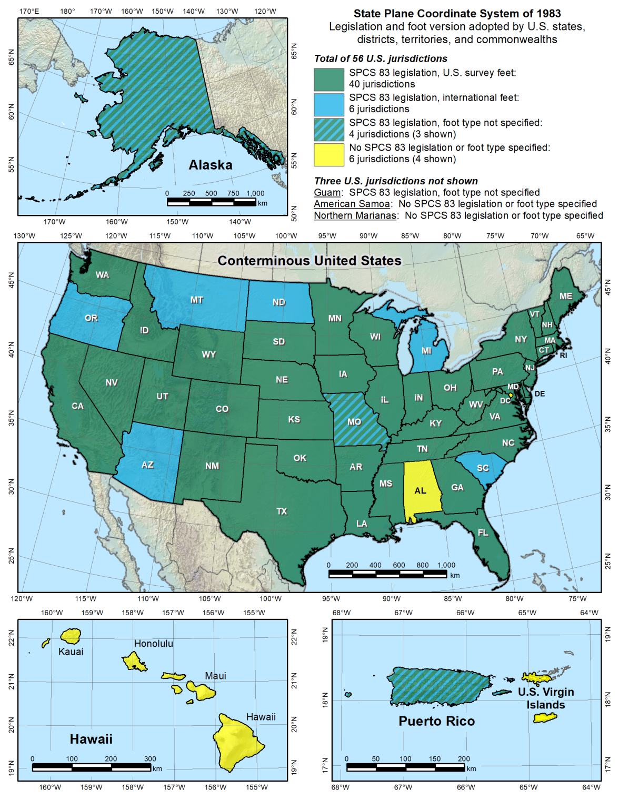

Slide 8
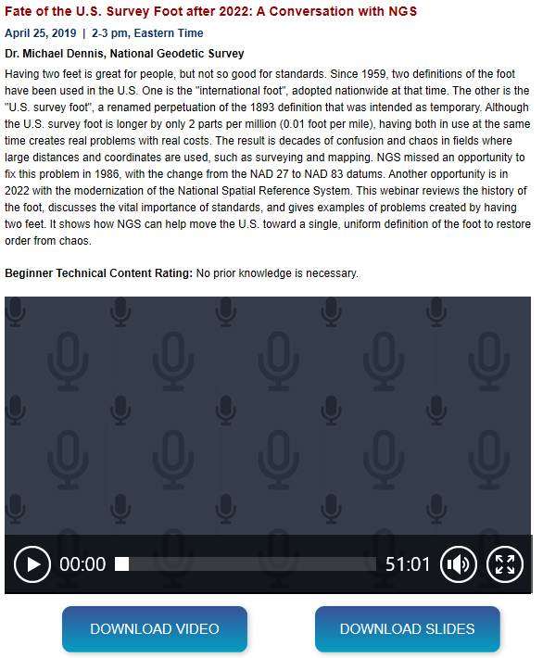

Slide 9
Questions?
Gary Thompson, PLS
NC Emergency Management
Risk Management/Geodetic Survey
4105 Reedy Creek Road
Raleigh, NC 27607
Main office: 919-733-3836
Direct line: 919-948-7844
gary.thompson@ncdps.gov

